Slide 1

Goal Umpiring
© Australian Football League – 2018. This document is confidential and intended solely for the use and information of the addressee

Slide 2
        Recording Of Scores By Goal Umpires
        RECORD PROGRESSIVELY
        Record the scores progressively, that is, 1, 2, 3, rather than 1 1 1.
      CONFER EACH QUARTER
      At the end of each quarter, the goal umpires confer to check each has the same score.
      If the scores are not the same, the goal umpires discuss the situation during the break and try to resolve the matter.
        As a guide, there are three general rules for resolving different scores:
        1. It is often the goal umpire at the non-scoring end who has the accurate score as he has not been under pressure to make decisions.
        2. It is easier to ‘forget’ to record a score than it is to add a score in error. Therefore, the umpire with the extra score is usually correct.
        3. If there is a scoreboard, check the scoreboard. The goal umpire with the same score as the scoreboard is usually correct as the other umpire may have made a mistake.
© Australian Football League – 2018. This document is confidential and intended solely for the use and information of the addressee

Slide 3
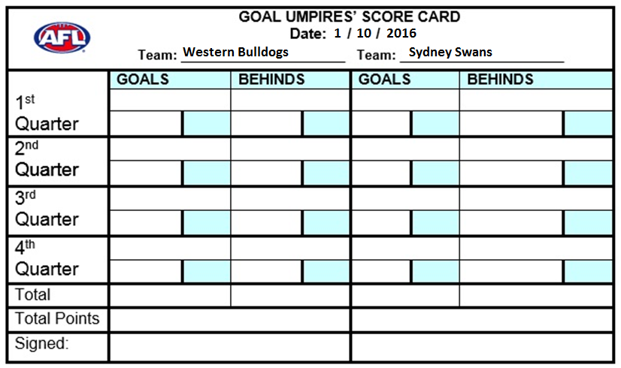
© Australian Football League – 2018. This document is confidential and intended solely for the use and information of the addressee

Slide 4
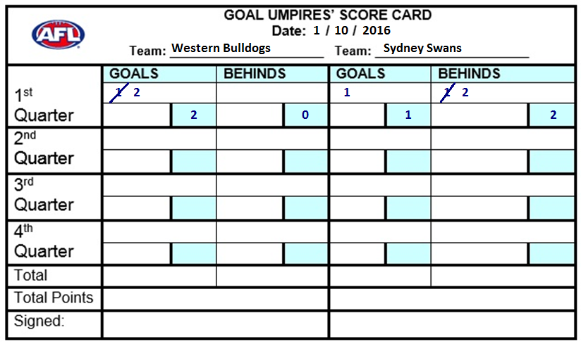
© Australian Football League – 2018. This document is confidential and intended solely for the use and information of the addressee

Slide 5
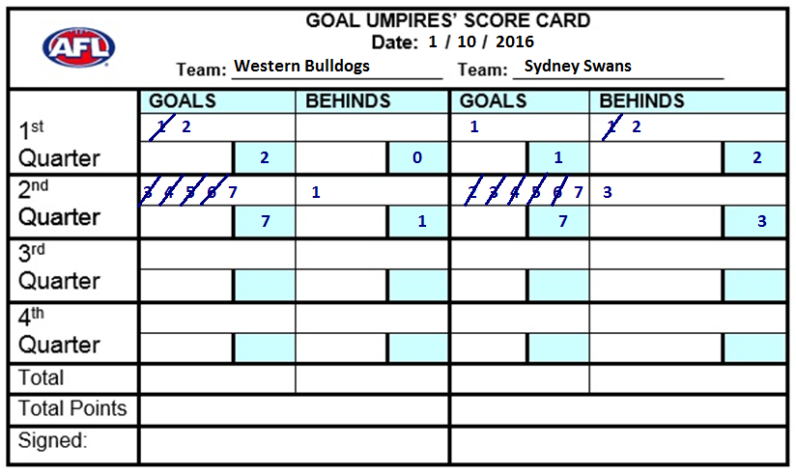
© Australian Football League – 2018. This document is confidential and intended solely for the use and information of the addressee

Slide 6
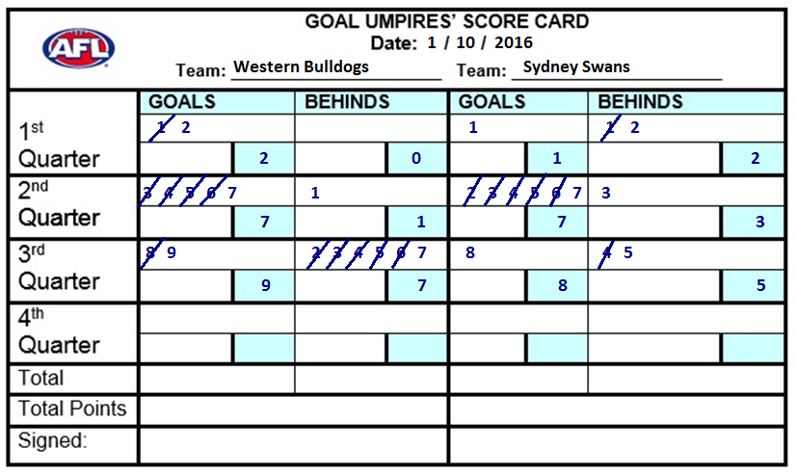
© Australian Football League – 2018. This document is confidential and intended solely for the use and information of the addressee

Slide 7
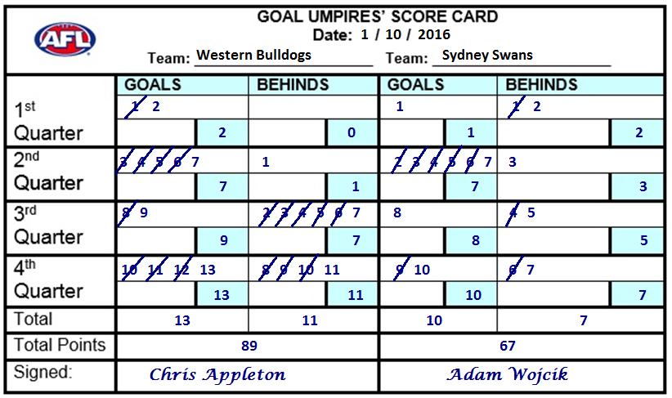
© Australian Football League – 2018. This document is confidential and intended solely for the use and information of the addressee

Slide 8
Responsibilities of a Goal Umpire
Apply the laws of the game relating to goal umpiring.
Be the final judge of a score.
Keep a record of all the goals and behinds scored in a match.
Furnish a report to the controlling body
© Australian Football League – 2018. This document is confidential and intended solely for the use and information of the addressee

Slide 9

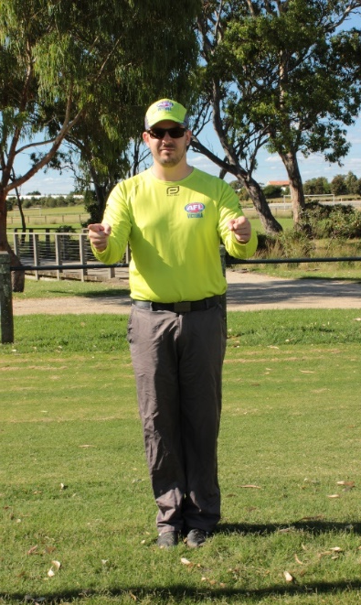
Goal Umpire Indications
        Whether for a goal or a behind, your indications with your hands and arms should be clear and precise.
        This reflects the confidence you have with the decision you have made.
        This type of indicating gives the players and officials confidence in your decisions.
© Australian Football League – 2018. This document is confidential and intended solely for the use and information of the addressee

Slide 10
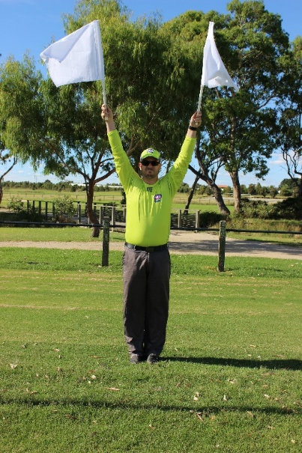
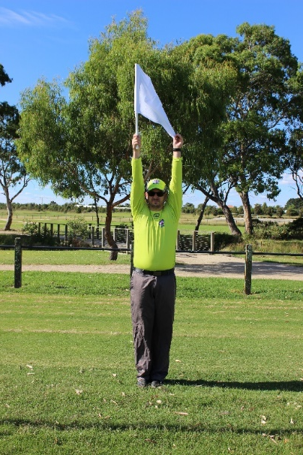
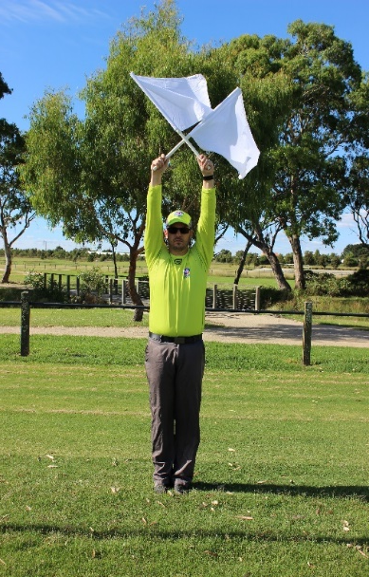
Signalling a Score
        This style should also be reflected in your flag-waving.
        Your flag-waving completes your indication process and must be of a high standard.
© Australian Football League – 2018. This document is confidential and intended solely for the use and information of the addressee

Slide 11
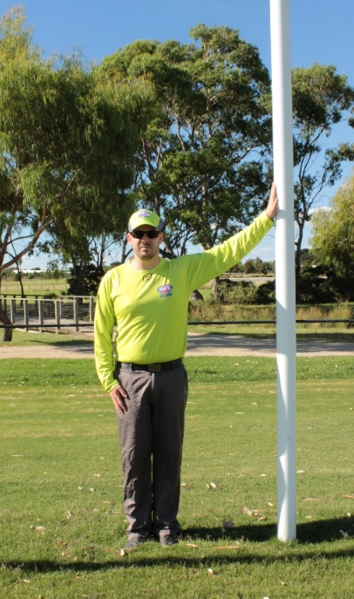

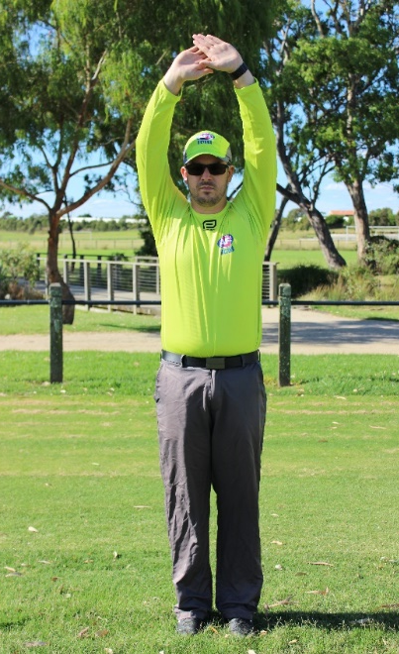
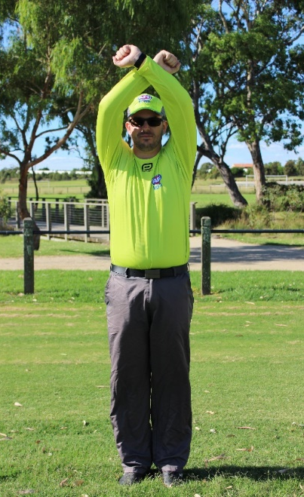
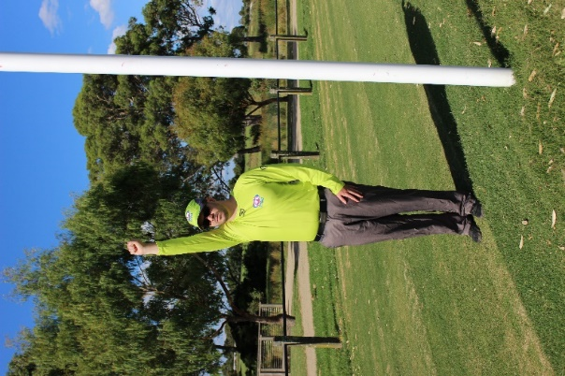
Other Goal Umpire’s signals
Ball touched goal post. Follow with behind signal.
Ball touched leg above knee. Follow with a behind signal.
Ball was touched. Follow with a behind signal.
Blood rule.
Out of bounds – to boundary umpire
© Australian Football League – 2018. This document is confidential and intended solely for the use and information of the addressee

Slide 12

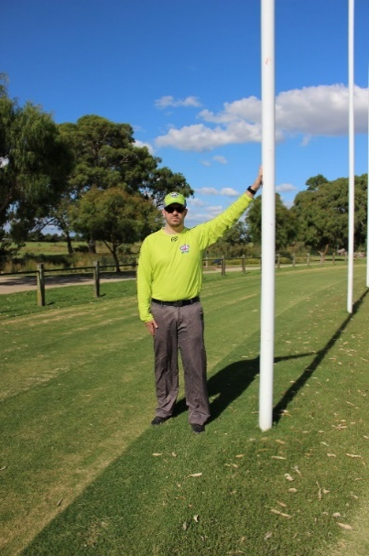
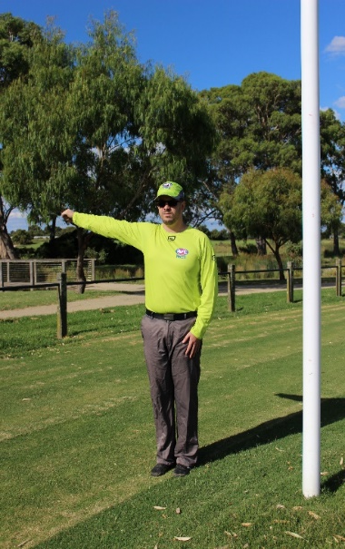
Other Goal Umpire’s signals
Behind has been scored – to boundary umpire
Ball hits behind post on full – tap three times
On the full – to boundary umpire
© Australian Football League – 2018. This document is confidential and intended solely for the use and information of the addressee

Slide 13
The Goal Umpire Positioning
        Any form of adjudication requires the umpire to be in the best possible position from which to correctly judge an outcome.
        Goal umpiring, without doubt, requires the umpire to be in the best possible position from which to determine the correct score.
        The standard positioning of a goal umpire comes under two categories:
        • Under the flight of the ball.
        • Astride the score line.
© Australian Football League – 2018. This document is confidential and intended solely for the use and information of the addressee

Slide 14
The Goal Umpire Positioning
      UNDER THE FLIGHT OF THE BALL
        For the goal umpire to correctly determine whether the football in flight has gone through the goals over a goal post, or through the behinds, he needs to position himself under the flight of the ball.
        When the ball is within scoring distance, the goal umpire’s initial position should be in line with the ball and the centre of the goal line.
        While the ball is in flight, the goal umpire should run to get underneath the line of the ball as it crosses the score line.
© Australian Football League – 2018. This document is confidential and intended solely for the use and information of the addressee

Slide 15
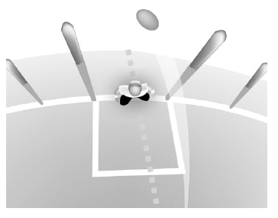
The Goal Umpire Positioning
UNDER THE FLIGHT OF THE BALL
© Australian Football League – 2018. This document is confidential and intended solely for the use and information of the addressee

Slide 16
The Goal Umpire Positioning
      ASTRIDE THE LINE
      There are some occasions that require the goal umpire to straddle (or stand astride) the score line and out of the way of the players.
        They are:
        • Ball dropping in flight.
        • Ball bouncing along the ground towards goal.
        • Player running for close kick.
        • Contest on goal/behind line.
© Australian Football League – 2018. This document is confidential and intended solely for the use and information of the addressee

Slide 17
The Goal Umpire Position
ASTRIDE THE LINE
© Australian Football League – 2018. This document is confidential and intended solely for the use and information of the addressee

Slide 18
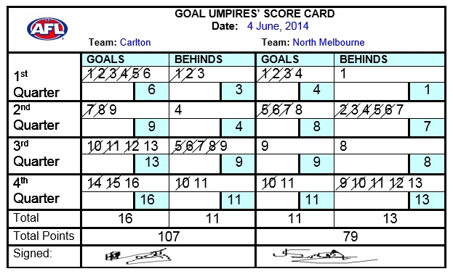
Recording of Scores by Goal Umpires
      TOTAL AT END OF MATCH
        Add up the goals and behinds scored by each team at the end of the match, and record the total scores.
        A sample scorecard that has been completed in the correct manner follows.
© Australian Football League – 2018. This document is confidential and intended solely for the use and information of the addressee

Slide 19
© Australian Football League – 2018. This document is confidential and intended solely for the use and information of the addressee

